Slide 1
OSTEOLOGY OF THE UPPER LIMB
BY
Dr. F.O. OPOOLA

Slide 2
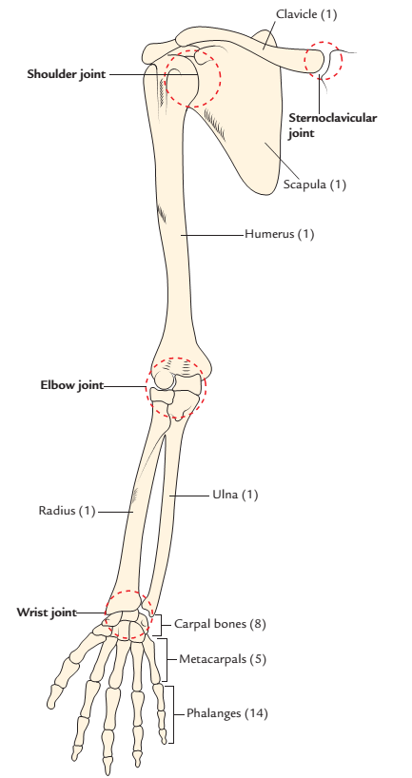
INTRODUCTION
Each upper limb contains 32 bones namely:
Bones of the pectoral girdle:
Scapula, the shoulder blade (1).
Clavicle, the collar bone (1).
Humerus, the bone of arm (1).
Radius and ulna, the bones of forearm (2).
Carpal bones, the bones of wrist (8).
Metacarpals, the bones of hand (5).
Phalanges, the bones of digits (fingers) (14).

Slide 3
CLAVICLE
The clavicle or collar bone is the long bone, with a slight S-shaped curve.
It is located horizontally on the anterior aspect of the body at the junction of root of the neck and trunk.
It articulates medially with the sternum and 1st rib cartilage and laterally with the acromion process of the scapula.
It is subcutaneous and hence it can be palpated through its entire extent.
It is the only bony attachment between the trunk and upper limb.

Slide 4
FUNCTIONS OF THE CLAVICLE
It acts as a strut for holding the upper limb far from the trunk so that it can move freely. This allows free swing of the upper limb and holding, catching, etc.
It transmits forces from the upper limb to the axial skeleton (sternum).
It provides an area for the attachment of muscles.

Slide 5
The features of the clavicle
It is the only long bone which lies horizontally.
It has no medullary cavity.
It is subcutaneous throughout its extent.
It is the first bone to start ossifying (between the fifth and sixth week of intrauterine life) and last bone to complete its ossification (at 25 years).
It is the only long bone which ossifies by two primary centers.
It is the only long bone which ossifies in membrane except for its medial end (long bones ossify in cartilage).
It may be pierced through and through by cutaneous nerve (supraclavicular nerve).

Slide 6
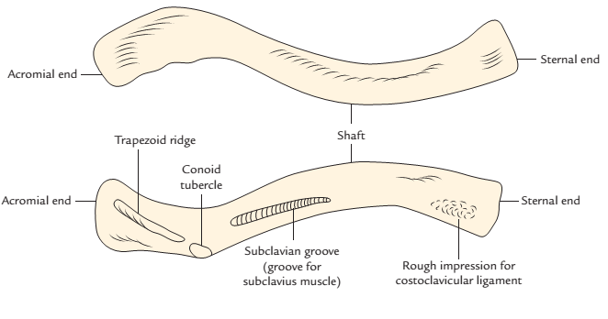
CLAVICLE
The clavicle consists of three parts: two ends (medial and lateral) and a shaft.
Ends:
The lateral (acromial) end is flattened above downwards and articulates with medial margin of the acromion process.
The medial (sternal) end is enlarged and quadrilateral. It articulates with the clavicular notch of the manubrium sterni.
Right clavicle: Upper one, superior aspect; Lower one, inferior aspect.

Slide 7
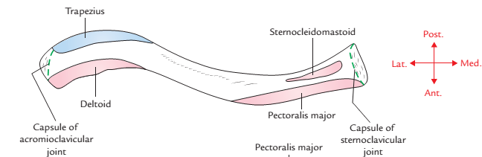
CLAVICLE
Shaft
The shaft is curved. Its medial two-third is round and convex forwards, and its lateral one-third is flattened and concave forwards. The inferior surface of the shaft possesses a small longitudinal groove in its middle third.
Right clavicle showing attachments of the muscles and ligaments:Superior surface.

Slide 8
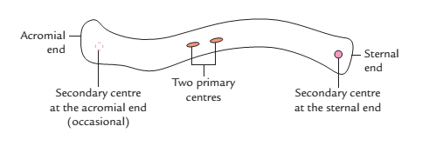
Ossification of the clavicle
The ossification of clavicle is membranocartilaginous.
It ossifies in the membrane except its medial end which ossifies in the cartilage. The clavicle begins to ossify before any other bone in the body. It ossifies by four ossification centres – two primary centres for shaft and two secondary centres, one for each end.

Slide 9
APPLIED ANATOMY
Fracture of clavicle: The clavicle is the most commonly fractured bone in the body. It commonly fractures at the junction of its lateral one-third and medial two-third due to blows to the shoulder or indirect forces, usually as a result of strong impact on the hand or shoulder, when person falls on the outstretched hand or the shoulder.
When fracture occurs, the lateral fragment is displaced downward by the weight of the upper limb because trapezius alone is unable to support the weight of the upper limb.

Slide 10
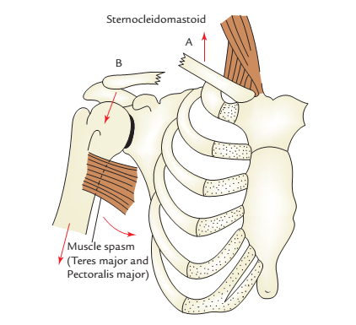
APPLIED ANATOMY
The fracture at the junction of lateral one-third and medial two-third occurs because:
This is the weakest site.
Two curvatures of clavicle meet at this site.
The transmission of forces (due to impact) from the clavicle to scapula occur at this site through coracoclavicular ligament.
Clavicle fracture: A, medial fragment;
B, lateral fragment

Slide 11
Congenital anomalies
Clavicular dysostosis: It is a clinical condition in which medial and lateral parts of clavicle remain separate due to non-union of two primary centers of ossification.
Cleidocranial dysostosis: It is a clinical condition characterized by partial or complete absence of clavicle associated with defective ossification of the skull bones.

Slide 12
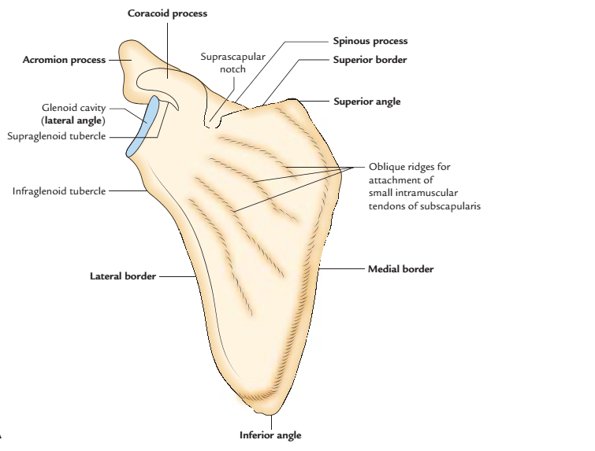
SCAPULA
The scapula (shoulder blade) is a large, flattened, and triangular bone located on the upper part of the posterolateral aspect of the thorax, against 2nd to 7th ribs.
PARTS
The scapula is highly mobile and consists of four parts: a body and three processes-spinous, acromion, and coracoid.
Right scapula: A, anterior aspect

Slide 13
SCAPULA
The body is triangular, thin, and transparent. It presents the following features:
Two surfaces: (a) costal and (b) dorsal.
Three borders: (a) superior, (b) lateral, and (c) medial.
Three angles: (a) inferior, (b) superior, and (c) lateral.
The dorsal surface presents a shelf-like projection on its upper part called spinous process.
The lateral angle is truncated to form an articular surface-the glenoid cavity.

Slide 14
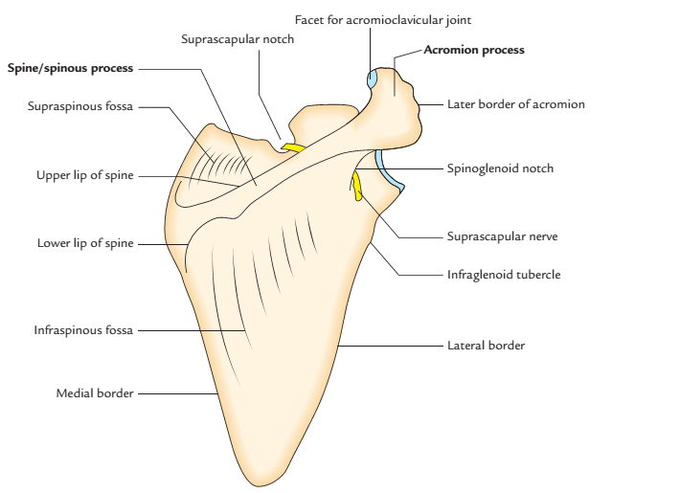
The lateral angle is thickened and called head of the scapula, which is connected to the plate-like body by an inconspicuous neck.
Right scapula: anterior aspect; posterior aspect.

Slide 15
SCAPULA
There are three processes. These are as follows:
Spinous process.
Acromion process.
Coracoid process.
The spinous process is a shelf-like bony projection on the dorsal aspect of the body.
The acromion process projects forwards almost at right angle from the lateral end of the spine.
The coracoid process is like a bird’s beak. It arises from the upper border of the head and bends sharply to project superoanteriorly.

Slide 16
SCAPULA
Surfaces
Costal surface (subscapular fossa)
It is concave and directed medially and forwards.
It presents three longitudinal ridges, which provide attachment to the intramuscular tendons of subscapularis muscle.
The subscapularis muscle (a multipennate muscle) arises from the medial two-third of subscapular fossa/ costal surface except near the neck where a subscapular bursa intervenes between the neck and the subscapular tendon.

Slide 17
OSSIFICATION
The ossification of scapula is cartilaginous.
The cartilaginous scapula is ossified by eight centres-one primary and seven secondary.
The primary centre appears in the body.
The secondary centres appear as follows:
Two centres appear in the coracoid process.
Two centres appear in the acromion process.
One centre appears each in the (a) medial border, (b) inferior angle, and (c) in the lower part of the rim of glenoid cavity.

Slide 18
OSSIFICATION
The primary centre in the body and first secondary centre in the coracoid process appears in eighth week of intrauterine life (IUL) and first year of postnatal life, respectively and they fuse at the age of 15 years.
All other secondary centres appear at about puberty and fuse by 20th year.

Slide 19
HUMERUS
The humerus is a long bone and consists of three parts: upper end, lower end, and shaft.
Upper End
The upper end presents the following five features:
Head.
Neck.
Greater tubercle.
Lesser tubercle.
Intertubercular sulcus

Slide 20
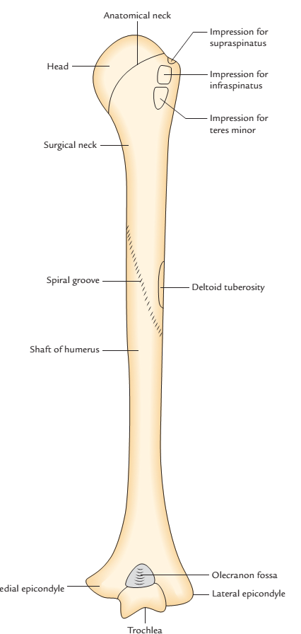
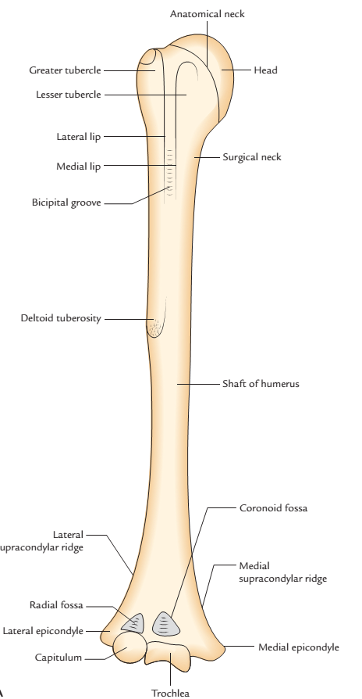
HUMERUS
Right humerus: anterior view; posterior view

Slide 21
HUMERUS
The head is smooth and rounded, and forms less than half of a sphere. It is directed medially backwards and upwards.
It articulates with the glenoid cavity of scapula to form the glenohumeral (shoulder) joint.

Slide 22
Lower End Of Humerus
The lower end presents the following features:
Capitulum, a lateral rounded convex projection.
Trochlea, a medial pulley-shaped structure.
Radial fossa, a small fossa above the capitulum.
Coronoid fossa, a small fossa above the trochlea.
Medial epicondyle, a prominent projection on the medial side.
Lateral epicondyle, a prominent projection on the lateral side but less than the medial epicondyle.

Slide 23
FEATURES AND ATTACHMENTS
Upper End Head
It is smooth, rounded and forms one-third of a sphere.
It is covered by an articular hyaline cartilage, which is thicker in the center and thinner at the periphery
Olecranon fossa, a large, deep hollow on the posterior aspect above the trochlea
Shaft
The shaft is a long part of bone extending between its upper and lower ends. It is cylindrical in the upper half and flattened anteroposteriorly in the lower half.

Slide 24
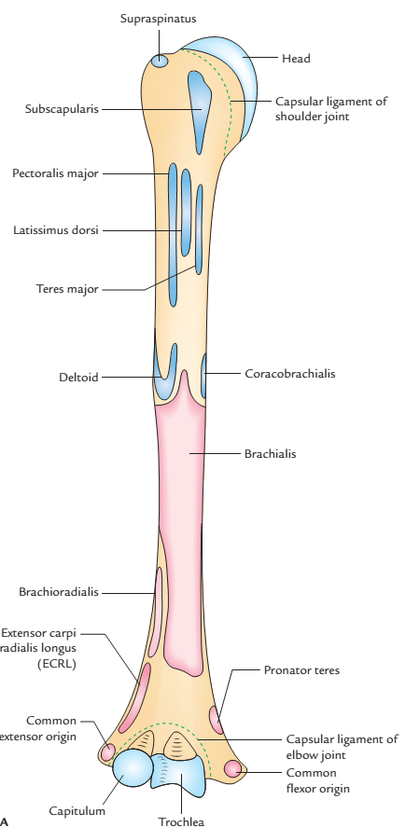
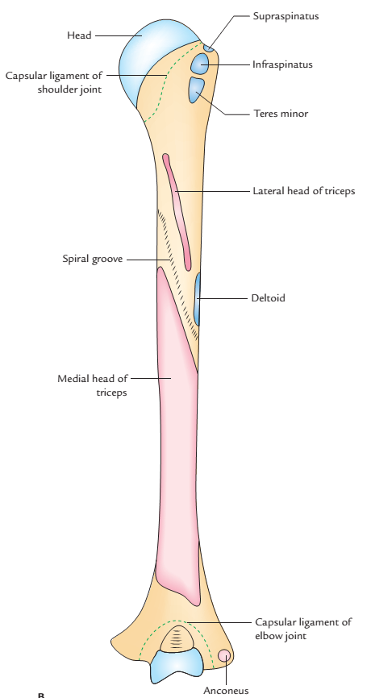
Right humerus showing attachments of the muscles and ligaments:
A, anterior aspect; B, posterior aspect

Slide 25
HUMERUS
The humerus has three necks:
Anatomical neck
It is constriction at the margins of the rounded head.
It provides attachment to the capsular ligament of the shoulder joint, except-superiorly where the capsule is deficient, for the passage of tendon of long head of biceps brachii, medially the capsule extends down from the anatomical neck to the shaft for about 1–2 cm.

Slide 26
HUMERUS
Surgical neck
It is short constriction in the upper end of the shaft below the greater and lesser tubercles/below the epiphyseal line.
It is related to axillary nerve and posterior and anterior circumflex humeral vessels.
It is the most important feature of the proximal end of the humerus because it is weaker than the more proximal regions of the bone, hence it is one of sites where the humerus commonly fractures leading to damage of associated nerves and vessels.

Slide 27
HUMERUS
Morphological neck
It is the junction between diaphysis and epiphysis.
It is represented by an epiphyseal line in the adult bone.
It is a true junction of head with the shaft.

Slide 28
HUMERUS
Greater tubercle
It is the most lateral part of the proximal end of humerus.
Its posterosuperior aspect bears three flattened facet-like impressions: upper, middle, and lower, which provide attachment to supraspinatus, infraspinatus, and teres minor muscles, respectively.
Lesser tubercle
It is small elevation on the front of upper end of humerus, just above the surgical neck.
It provides attachment to subscapularis muscle

Slide 29
OSSIFICATION
The humerus is ossified by the following ossification centres:
One primary centre for shaft.
Three secondary centres for upper end.
Four secondary centres for lower end.

Slide 30
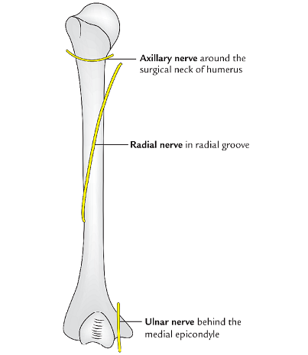
APPLIED ANATOMY
The three nerve (axillary, radial, and ulnar) are closely related to the back of humerus as follows:
Axillary nerve around the surgical neck.
Radial nerve in the radial/spiral groove
Ulnar nerve behind the medial epicondyle.
These nerves are often involved in the fracture of humerus at the above sites:
Common sites of fracture of the humerus: These are (a) surgical neck (b) shaft, and (c) supracondylar region.
Three nerves closely related to the back of the humerus

Slide 31
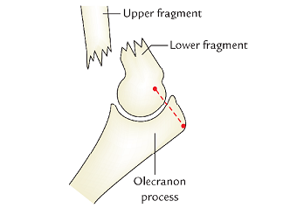
APPLIED ANATOMY
Supracondylar fracture of the humerus: It is caused by a fall on the outstretched hand and commonly occurs in young age. Anatomically, it presents as backwards displacement of the lower fragment with unduly prominent elbow, however the three bony points of elbow (medial epicondyle, lateral epicondyle, and olecranon process) form the usual equilateral triangle because the olecranon process always moves with the lower fragment.
Supracondylar fracture of
the humerus

Slide 32
APPLIED ANATOMY
This fracture may cause injury to median nerve and brachial artery. The injury to the brachial artery may cause Volkmann’s ischemic contracture .
Median nerve is most commonly involved in the Supracondylar fracture of the humerus
The separate centre for medial epicondyle and its late union with the shaft may be mistaken for the fracture of medial epicondyle of humerus.

Slide 33
RADIUS
The radius is the lateral bone of the forearm and is homologous to the medial bone of the leg, the tibia.
PARTS
The radius is a long bone and consists of three parts: upper end, shaft, and lower end.

Slide 34
RADIUS
Upper End
The upper end presents head, neck, and radial tuberosity.
The head is disc shaped and articulates above with the capitulum of humerus. The neck is constricted part below the head. The radial tuberosity is just below the medial part of the neck.
Shaft
The long shaft extends between the upper and lower ends and presents a lateral convexity. It widens rapidly towards the distal end and is concave anteriorly in its distal part. Its sharpest interosseous border is located on the medial side.

Slide 35
RADIUS
Lower End
The lower end is the widest part and presents five surfaces.
The lateral surface projects distally as the styloid process. The dorsal surface presents a palpable dorsal tubercle (Lister’s tubercle), which is limited medially by an oblique groove.

Slide 36
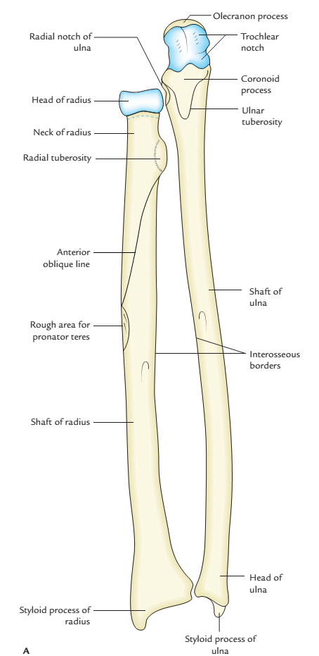
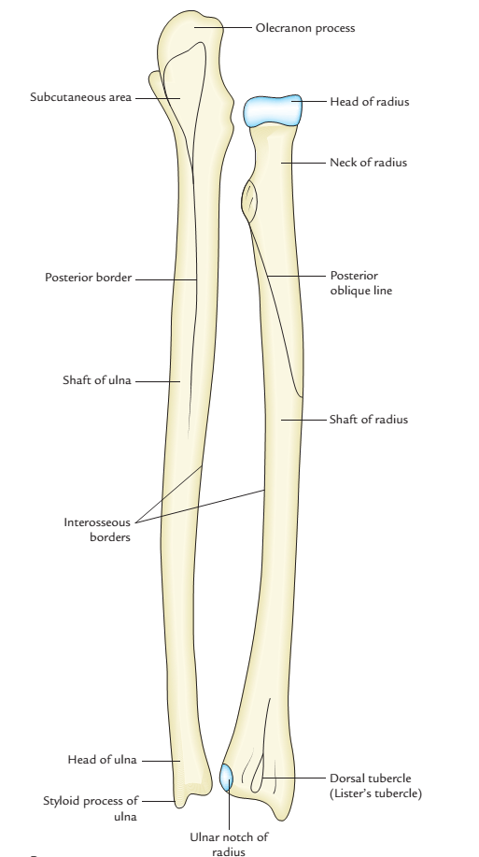
Right radius and ulna: Anterior view

Slide 37
ANATOMICAL POSITION
The side of radius can be determined by keeping the bone vertically in such a way that:
The narrow disc-shaped end(head) is directed upwards.
The sharpest border (interosseous border) of the shaft is kept medially.
The styloid process at the lower end is directed laterally and prominent tubercle (Lister’s tubercle) at lower end faces dorsally.
The convexity of shaft faces laterally, and concave anterior surface of shaft faces anteriorly.

Slide 38
Ossification
The radius ossifies from the following three centres:
One primary centre appears in the mid-shaft during 8th week of IUL.
Two secondary centres, one for each end:
Centre for lower end appears at the age of first year.
Centre for upper end appears during fifth year.
The upper epiphysis fuses at the age of 12 years.
The lower epiphysis fuses at the age of 20th year.

Slide 39
APPLIED ANATOMY
The radius is a weight-bearing bone of the forearm; hence fractures of radius are more common than ulna.
In fracture shaft of radius, with fracture line below the insertion of biceps and above the insertion of pronator teres the upper fragment is supinated by supinator and lower fragment is pronated by the pronator teres.
In fracture at the distal end of radius (Colles’ fracture) the distal fragment is displaced backwards and upwards. The reverse of Colles’ fracture is called Smith’s fracture.

Slide 40
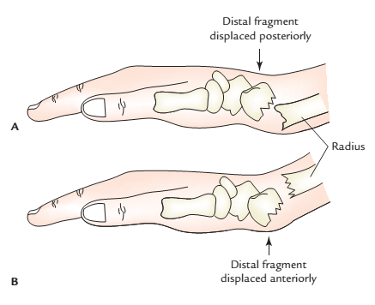
Fracture of styloid process of radius is termed ‘Chauffeur’s fracture’
The radius is most commonly fractured bone in people over 50 years of age. It is often fractured as a result of a fall on outstretched hand.
Fracture at distal end of the radius: A,Colles’ fracture; B, Smith’s fracture

Slide 41
ULNA
The ulna is the medial bone of forearm and is homologous to the lateral bone of leg-the fibula.
PARTS
The ulna is a long bone and consists of three parts: upper end, lower end, and shaft.
Upper End
The upper end is expanded and hook-like with concavity of hook facing forwards. The concavity of upper end (trochlear notch) lies between large olecranon process above and the small coronoid process below.

Slide 42
ULNA
Shaft
The long shaft extends between the upper and lower ends. Its thickness diminishes progressively from above downwards throughout its length. The lateral border (interosseous border) is sharp crest-like.
Lower End
The lower end is slightly expanded and has a head and styloid process. The styloid process is posteromedial to the head.

Slide 43
ANATOMICAL POSITION
It can be determined by keeping the side of ulna bone vertically in such a way that:
The broad hook-like end is directed upwards.
The sharp crest-like interosseous border of shaft is directed laterally.
The concavity of the hook-like upper end and the coronoid process are facing forwards

Slide 44
FEATURES AND ATTACHMENTS
Upper End
The upper end has two processes: coronoid and olecranon, and two notches: trochlear and radial.
Processes
Olecranon process: It projects upwards from the upper end and bends forward at its summit like a beak. It has the following five surfaces:

Slide 45
Notches (articular surfaces)
Trochlear notch
It is C-shaped (semilunar) and articulates with the trochlea of humerus.
It has a non-articular strip at the junction of its olecranon and coronoid parts.
Its superior, medial, and anterior margins provide attachment to capsule of the elbow joint.
Radial notch
It articulates with the head of radius to form the superior radio-ulnar joint.

Slide 46
Ossification
The ulna ossifies from the three main centres: one primary centre for the shaft and two secondary centres, one each for the lower end and the upper end.

Slide 47
APPLIED ANATOMY
A fracture of the shaft of ulna due to direct injury when a night watchman reflex raises his forearm to ward off the blow of the stick is termed night-stick fracture.
When the elbow is fully extended, the tip of olecranon process and medial and lateral epicondyles of the humerus lie in a same horizontal line. When the elbow is fully flexed the three bony points form an equilateral triangle. In dislocation of elbow this relationship is disturbed.

Slide 48
APPLIED ANATOMY
Ulna stabilizes the forearm by gripping the lower end of humerus by its trochlear notch and provides foundation for radius to produce supination and pronation at superior and inferior radio-ulnar joints.
The fracture of upper third of shaft of ulna with dislocation of radial head at superior radio-ulnar joint is called Monteggia fracture dislocations.
The fracture of lower third of the shaft of radius associated with dislocation of inferior radio-ulnar joint is called Galeazzi fracture dislocation.

Slide 49
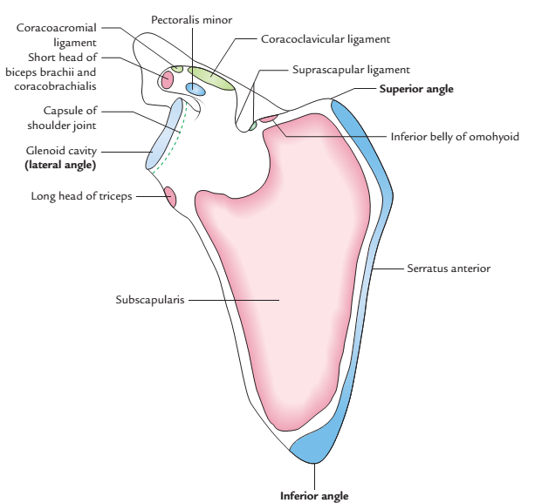
Right scapula showing attachments of the muscles and ligaments:
costal surface.

